Slide 1

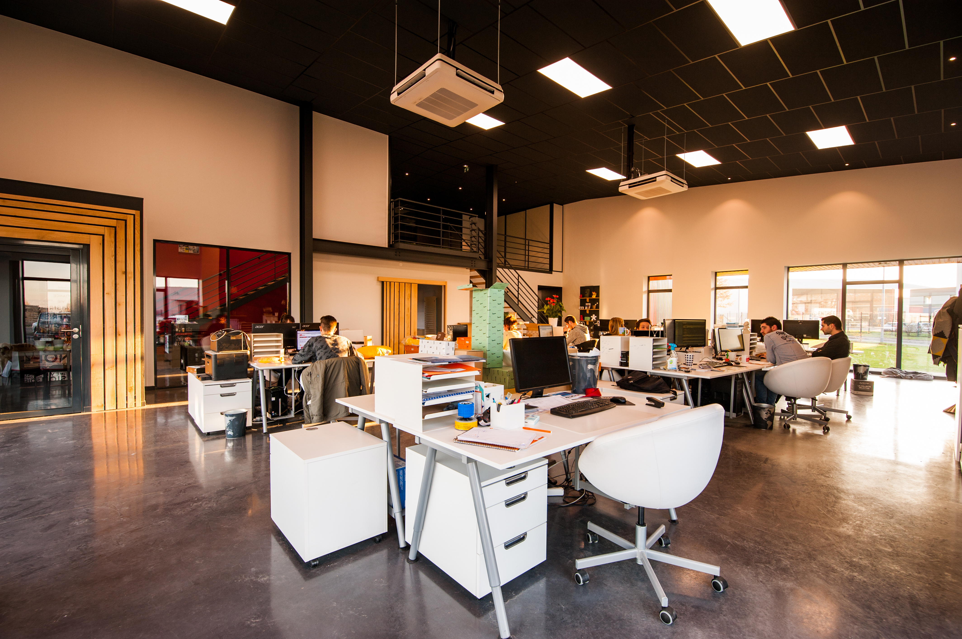
Final Project
Superstore Sales

Slide 2

What is the purpose and outcome of this project?
Purpose: Analyze sales by region and identify the supermarket's best-selling products.
Outcome: A set of actionable insights that show which regions generate the most revenue and which specific products contribute the most to overall sales.

Slide 3
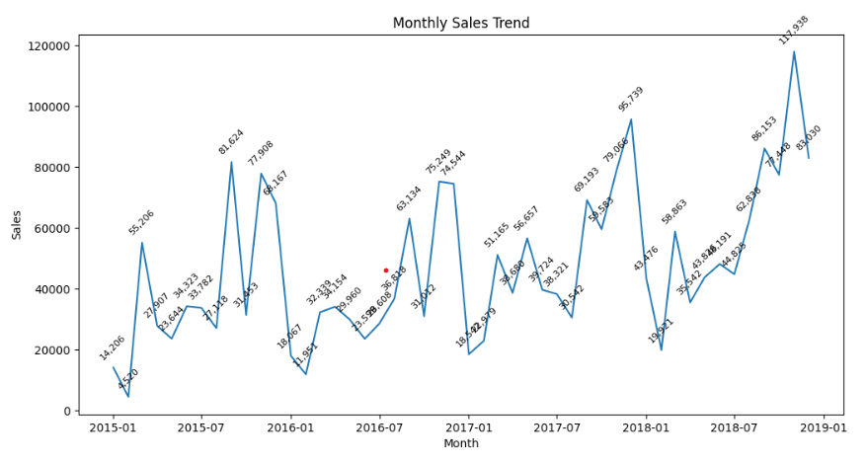

Monthly sales revenue
Revenue comparison by month
1. Starting from August 2025, revenue is higher than in the first months of the year. Customers have a need to buy goods at the end of the year and that is also the peak season.
2. In 2016, revenue decreased significantly compared to the same period in 2015. By November, revenue began to increase again.
3. From 2017 onwards, the company has a fixed and loyal customer base. Therefore, revenue is also higher than in 2015.

Slide 4
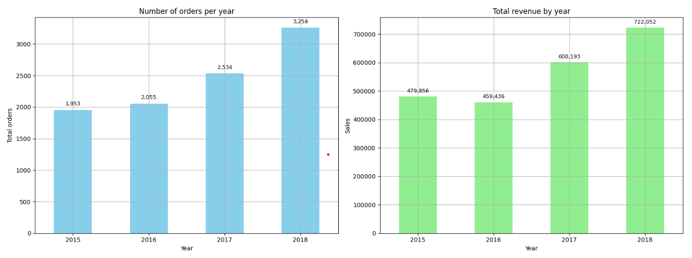
Compare sales and orders year by year

Slide 5
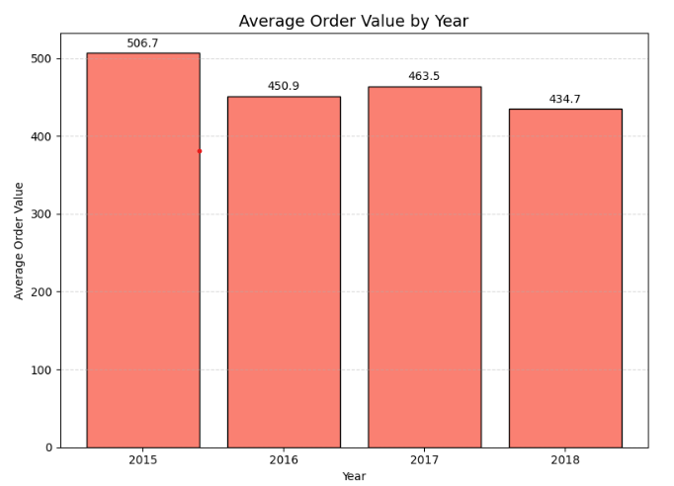
Average per order
Why is the order value getting lower every year?
1. In 2015, although the number of orders was low, the revenue was quite stable, the highest order value in 4 years.
2. In 2016, the number of orders increased, the revenue and value were lower than in 2015. This shows that customers spent less on each order.
3. In 2018, the number of orders and revenue were the highest, but the average order value was the lowest.
-> It may come from standard class customers, they do not spend much on each order or buy cheap products.

Slide 6
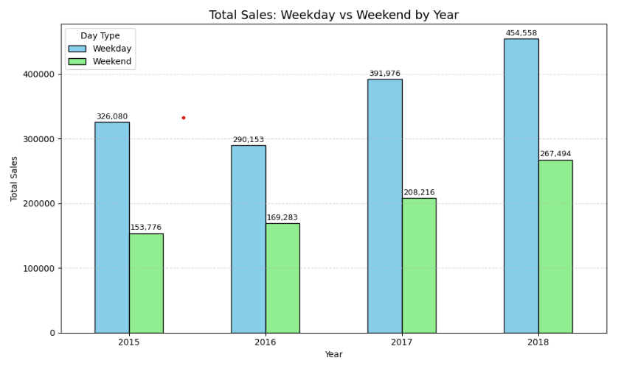
Revenue during the week compared to the weekend
Why is weekday sales higher than weekend sales
1. Weekday sales are always much higher than weekend sales. It seems that consumer behavior mainly occurs on working days.
2. Our main customers are mainly from businesses and can also buy in large quantities.

Slide 7
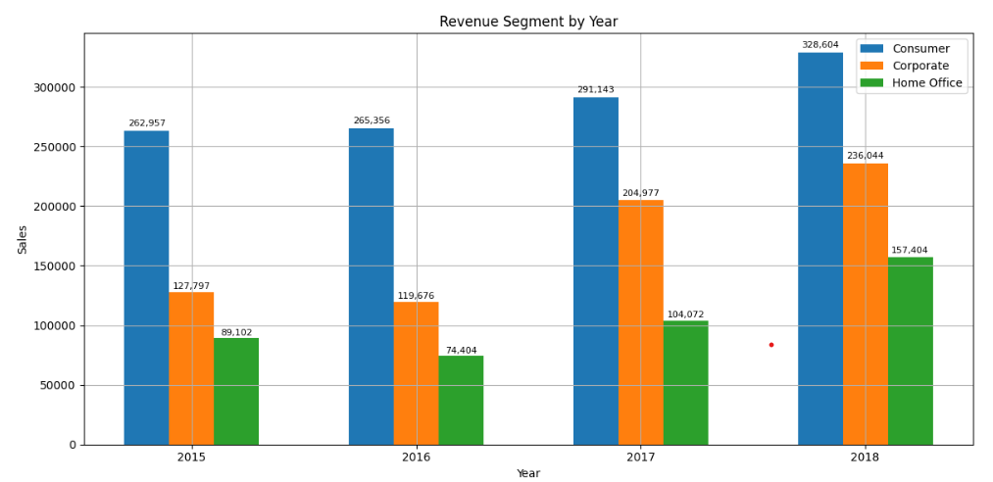
Revenue by segment
Customer segmentation analysis
1. In 4 years, revenue in 2016 decreased significantly compared to the remaining years. Especially the Home Office segment, the lowest in the years.
2. In 2018, the Corporate and Home Office segments doubled compared to the previous 3 years. It can be seen that revenue has improved significantly after 2016.
3. The main segment of supermarkets is still Consumer, leading over 4 years.
4. Home office and Coperate are in the development stage in the market, it is possible to consider to develop strategies and marketing to focus on these two segments.

Slide 8
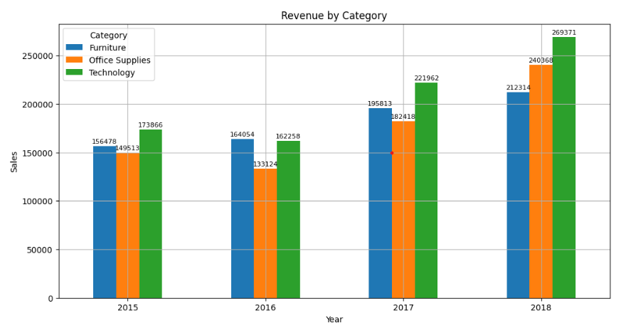
Revenue by Category
Why is the Technoly category growing the most?
1. The furniture category ranked second in revenue among the three categories, but grew the slowest. Perhaps customers are not too interested in Furniture.
2. Office Supplies in 2018 is doubling compared to 2015, perhaps because of a change in sales policy after a decline in revenue in 2016.
3. It can be seen that Technology is always at the top of the category, this is the year of the beginning of the 4.0 industrial revolution, so the market is showing a strong trend of developing the Technology industry, customers are willing to spend money to buy technology products to serve their work.
4. In addition, the development of the Technology market leads to businesses wanting to expand their company's scale, they are willing to open more offices. From there, customers will also be willing to spend on the Office Supplies category.

Slide 9
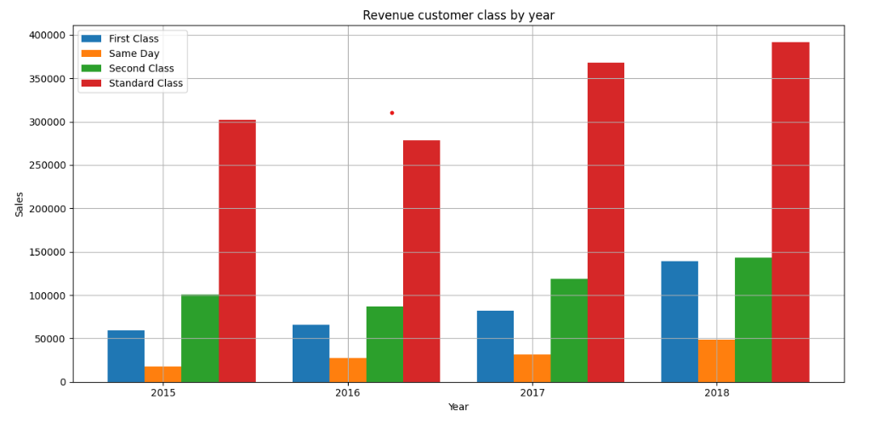
Revenue by customer class
Who is your customer class market?
1. Standard class has the highest revenue and is superior to the remaining customer classes. This is our main customer, so we should maintain this loyal customer base and offer many incentive programs to thank them.
2. Second class has shown signs of increasing over the years and has the potential to become loyal customers. Create discount or combo programs to attract customers, but still ensure quality to turn them into loyal customers.
3. First class grew strongly in 2018 and their revenue is equal to second class. Maybe First class customers are starting to care about Technology or about price.
4. For Same day customers, this may not be our target customer group, so the revenue is the lowest compared to the remaining customer classes

Slide 10
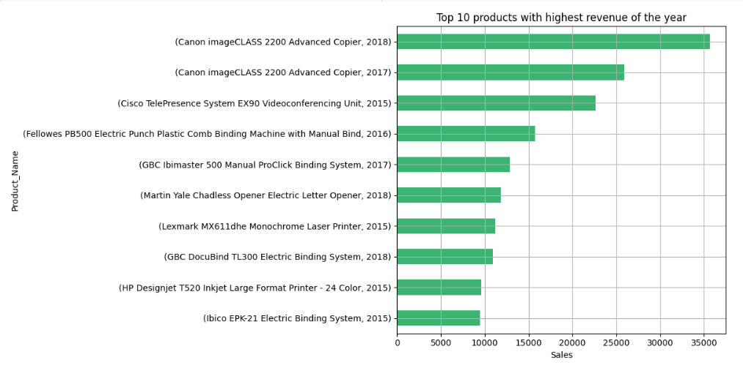
Top 10 highest revenue products in 4 years

Slide 11
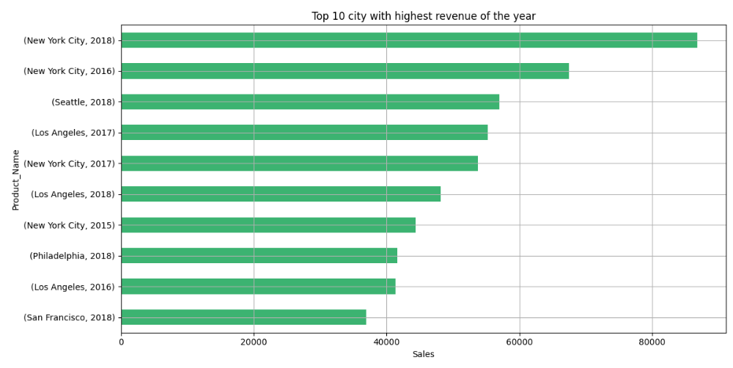
Top 10 highest revenue cities in 4 years

Slide 12
1. Economic trends are changing, leading to changes in customer purchasing needs.
2. Customers are willing to spend more on technology products than office products.
3. The decrease in revenue in 2016 is not due to delivery time.
4. New York has the highest revenue every year, showing that the trend of investing in technology in this state is increasing.
5. In particular, customers have the highest demand for printers in 4 years, maybe they start to expand their offices.
Revenue Trend Analysis

Slide 13



Conclusion
What to do to increase revenue from the furniture category?
Business analysis is the bridge between ideas and outcomes.
How to increase revenue per order?

Slide 14


Thank You So Much

